Slide 1



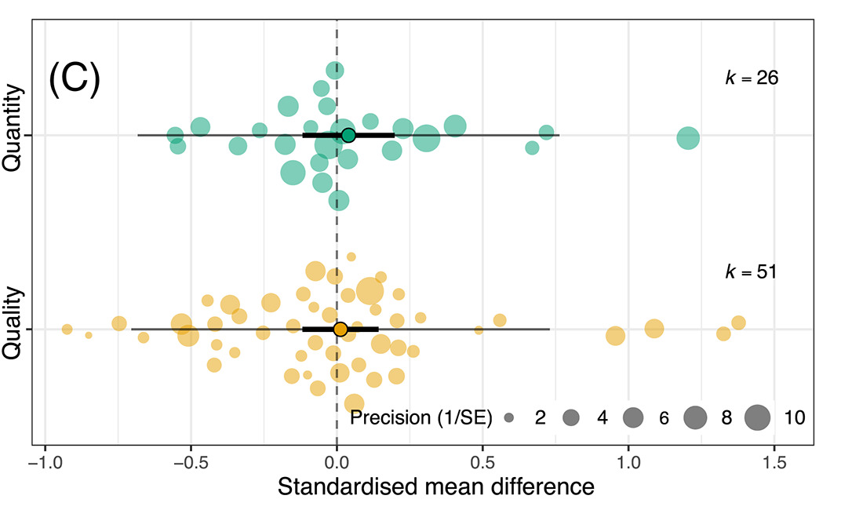
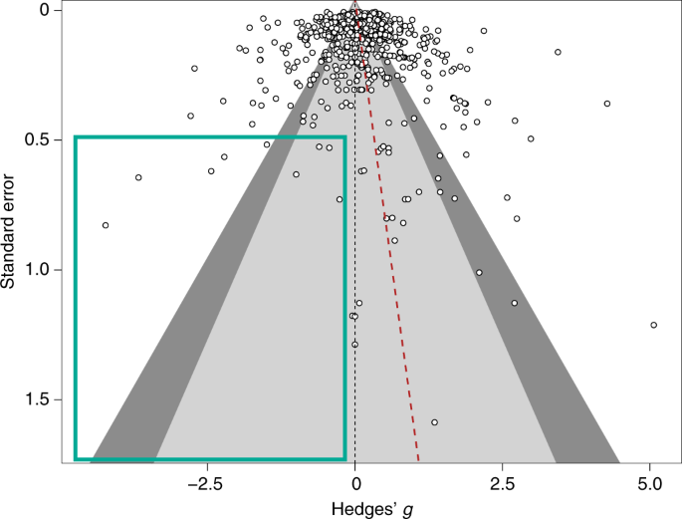




#SEBmeta
Meta-analysis in Comparative Physiology PART 2: Introduction to meta-analytic modelling: common challenges and advanced concepts
Nakagawa et al. 2021
De Boer et al. 2021
Daniel Noble, Nicholas Wu, Essie Rodgers, Patrice Pottier

Slide 2
Workshop Overview
Part 1: 9:00 – 10:30
What is meta-analysis and why should we use it?
Effect size and sampling variance: the key data for meta-analysis
What are effect sizes?
What types are out there and when to use?
Standardizing effect estimates – nuisance heterogeneity
Interpreting effect sizes and transformations
Assumptions, limitations, and common challenges
Part 2: 11:00 – 12:30
Meta-analytic modelling
Fixed and random effect meta-analyses
Multi-level meta-analytic models (MLMA): The main types in comparative physiology
Non-independence – phylogeny, study, species, shared controls
Robust variance estimation
Sensitivity analyses
Meta-regression and heterogeneity
Interpreting and reporting meta-analytic model output
Publication bias
Time-lag, reporting bias
Detecting and correcting
Part 3: 14:45 – 16:00
Help (advice) with your own meta-analysis! (if you need it)

Slide 3
Two main aims of meta-analysis
Finding generality across studies on the same (similar) topics
Meta-analysis
Finding consistency (inconsistency) among studies – just looking at means may not be useful
Heterogeneity analysis
Meta-regression
Publication-bias tests

Slide 4
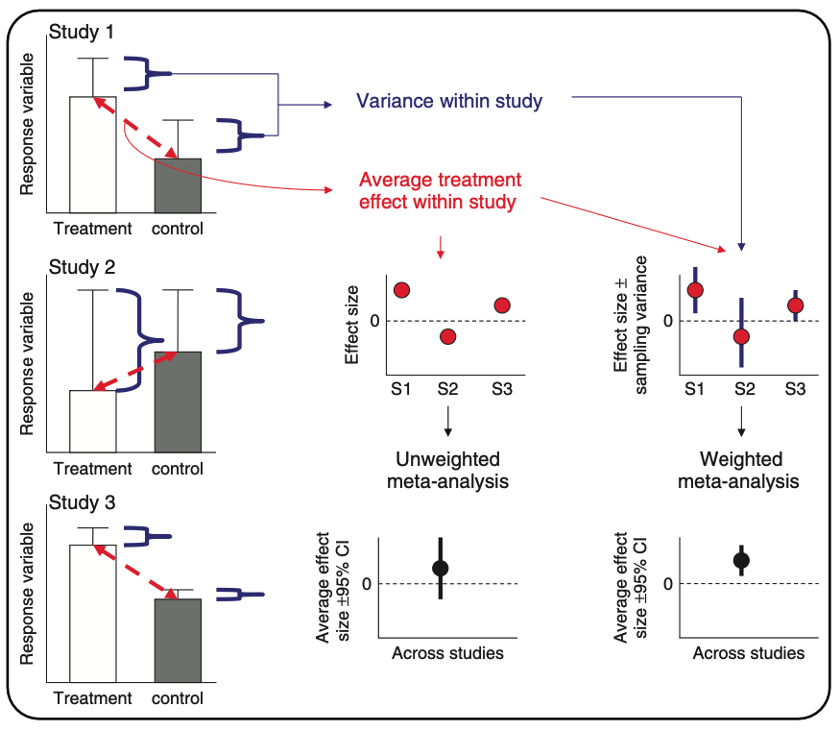
What meta-analysis is doing…
Hillebrand & Gurevitch (2016). eLS

Slide 5
Meta-analysis
Fixed-effect (common-effect) and random-effects meta-analyses
Heterogeneity tests
Meta-regression (mixed-effects meta-analysis)
Publication bias
Are studies with significant results more likely to be published?

Slide 6
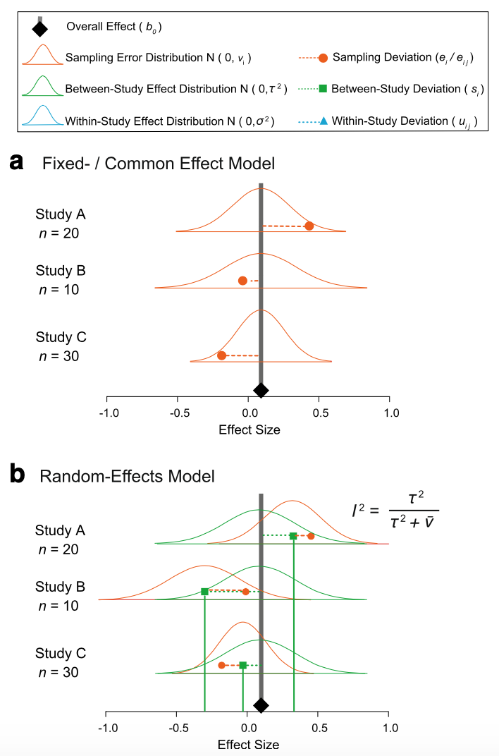

Fixed and random model assumptions
Fixed (common) effect
All studies are estimating the same (common) “true” underlying effect
Variability between studies is due to random variation (chance) only

Slide 7
Fixed and random model assumptions
Random effects
Each study has different “true” underlying effects
Variability between studies is due to random variation (chance) and actual differences

Slide 8
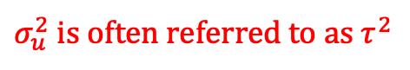
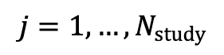
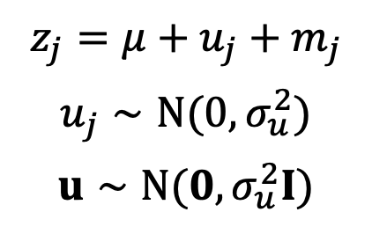
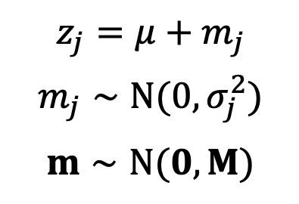
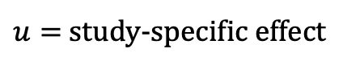
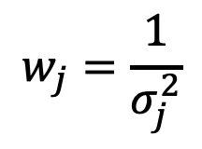
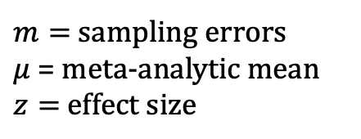
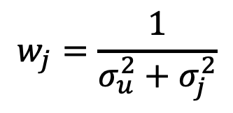
Fixed (common) and random: it’s just another linear model
Fixed-effect meta-analysis
(common-effect meta-analysis)
Random-effects meta-analysis
$$z_{j}=μ+m_{j}$$
$$m_{j}∼N(0,σ_{j}^{2})$$
$$m∼N(0,M)$$
$$z_{j}=μ+u_{j}+m_{j}$$
$$u_{j}∼N(0,σ_{u}^{2})$$
$$u∼N(0,σ_{u}^{2}I)$$
$$w_{j}=\frac{1}{σ_{j}^{2}}$$
$$w_{j}=\frac{1}{σ_{u}^{2}+σ_{j}^{2}}$$
$$j=1,…,N_{study}$$
$u=$ study-specific effect
$m=$ sampling errors
$μ$ = meta-analytic mean
$z=$ effect size
$σ_{u}^{2}$ is often referred to as $τ^{2}$
Nakagawa & Santos (2012, Evol Ecol)
Notes:
Need to add more

Slide 9
Fixed (common) effect in code…
# Generate some simulated effect size data with known sampling variance # assumed to come from a common underlying distribution set.seed(86) # Set see so that we all get the same simulated results
# We will have 5 studies stdy <- 1:5
# We know the variance for each effect Ves <- c(0.05, 0.10, 0.02, 0.10, 0.09)
# We'll need this later but these are weights W <- 1 / Ves
# We assume they are sampled from a normal distribution with a mean effect size of 2 es <- rnorm(length(Ves), 2, sqrt(Ves))
# Data for our fixed effect meta-analysis dataFE <- data.frame(stdy = stdy, es, Ves)

Slide 10
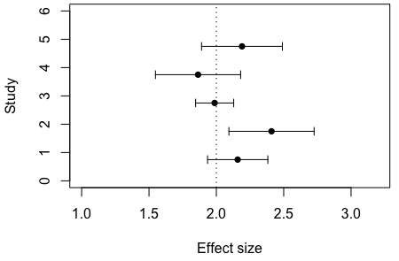
Fixed effects model data…

Slide 11
Fixed effect model meta-analysis..
# Run a fixed effect meta-analysis using the FE dataset. metafor::rma(yi = es, vi = Ves, method = "FE", data = dataFE)
## ## Fixed-Effects Model (k = 5) ## ## I^2 (total heterogeneity / total variability): 0.00% ## H^2 (total variability / sampling variability): 0.56 ## ## Test for Heterogeneity: ## Q(df = 4) = 2.2340, p-val = 0.6928 ## ## Model Results: ## ## estimate se zval pval ci.lb ci.ub ​ ## 2.0731 0.0994 20.8459 <.0001 1.8782 2.2680 *** ## ## --- ## Signif. codes: 0 '***' 0.001 '**' 0.01 '*' 0.05 '.' 0.1 ' ' 1

Slide 12
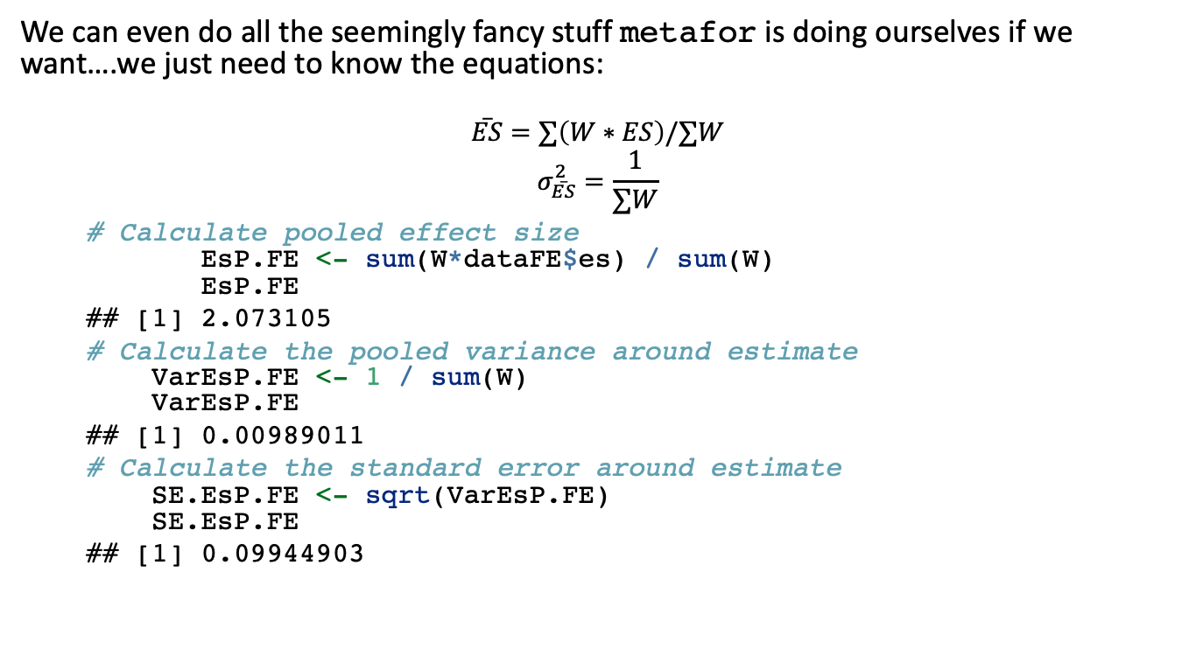
Now a fixed effect analysis by hand…
We can even do all the seemingly fancy stuff metafor is doing ourselves if we want….we just need to know the equations:
$$\overset{‾}{ES}=∑\left(W∗ES\right)/∑W$$
$$σ_{\overset{‾}{ES}}^{2}=\frac{1}{∑W}$$
# Calculate pooled effect size EsP.FE <- sum(W*dataFE$es) / sum(W) EsP.FE
## [1] 2.073105
# Calculate the pooled variance around estimate VarEsP.FE <- 1 / sum(W) VarEsP.FE
## [1] 0.00989011
# Calculate the standard error around estimate SE.EsP.FE <- sqrt(VarEsP.FE) SE.EsP.FE
## [1] 0.09944903
# We'll need this later but these are weights W <- 1 / Ves
## estimate se zval pval ci.lb ci.ub ​ ## 2.0731 0.0994 20.8459 <.0001 1.8782 2.2680 ***

Slide 13
Now a fixed effect analysis by hand…
We can even do all the seemingly fancy stuff metafor is doing ourselves if we want….we just need to know the equations:
$$\overset{‾}{ES}=∑\left(W∗ES\right)/∑W$$
$$σ_{\overset{‾}{ES}}^{2}=\frac{1}{∑W}$$
# Calculate pooled effect size EsP.FE <- sum(W*dataFE$es) / sum(W) EsP.FE
## [1] 2.073105
# Calculate the pooled variance around estimate VarEsP.FE <- 1 / sum(W) VarEsP.FE
## [1] 0.00989011
# Calculate the standard error around estimate SE.EsP.FE <- sqrt(VarEsP.FE) SE.EsP.FE
## [1] 0.09944903
# We'll need this later but these are weights W <- 1 / Ves
## estimate se zval pval ci.lb ci.ub ​ ## 2.0731 0.0994 20.8459 <.0001 1.8782 2.2680 ***

Slide 14
Now a fixed effect analysis by hand…
We can even do all the seemingly fancy stuff metafor is doing ourselves if we want….we just need to know the equations:
$$\overset{‾}{ES}=∑\left(W∗ES\right)/∑W$$
$$σ_{\overset{‾}{ES}}^{2}=\frac{1}{∑W}$$
# Calculate pooled effect size EsP.FE <- sum(W*dataFE$es) / sum(W) EsP.FE
## [1] 2.073105
# Calculate the pooled variance around estimate VarEsP.FE <- 1 / sum(W) VarEsP.FE
## [1] 0.00989011
# Calculate the standard error around estimate SE.EsP.FE <- sqrt(VarEsP.FE) SE.EsP.FE
## [1] 0.09944903
## estimate se zval pval ci.lb ci.ub ​ ## 2.0731 0.0994 20.8459 <.0001 1.8782 2.2680 ***

Slide 15

Now a fixed effect analysis by hand…
We can even do all the seemingly fancy stuff metafor is doing ourselves if we want….we just need to know the equations:
$$\overset{‾}{ES}=∑\left(W∗ES\right)/∑W$$
$$σ_{\overset{‾}{ES}}^{2}=\frac{1}{∑W}$$
# Calculate pooled effect size EsP.FE <- sum(W*dataFE$es) / sum(W) EsP.FE
## [1] 2.073105
# Calculate the pooled variance around estimate VarEsP.FE <- 1 / sum(W) VarEsP.FE
## [1] 0.00989011
# Calculate the standard error around estimate SE.EsP.FE <- sqrt(VarEsP.FE) SE.EsP.FE
## [1] 0.09944903
## estimate se zval pval ci.lb ci.ub ​ ## 2.0731 0.0994 20.8459 <.0001 1.8782 2.2680 ***
Notes:
2.073105 / 0.09944903 gets you the zval
2*pnorm(20.8459, lower.tail = FALSE) gets you the p-value for this

Slide 16
Random effect model in code….
# Here adding 0.8 says we want to add 0.8 as the between study variability. In other words, each effect size is sampled from a larger distribution of effect sizes that itself comes from a distribution with a variance of 0.8.
esRE <- rnorm(length(Ves), 2, sqrt(Ves + 0.8))
# Data for our random effect meta-analysis dataRE <- data.frame(stdy = stdy, esRE, Ves)

Slide 17
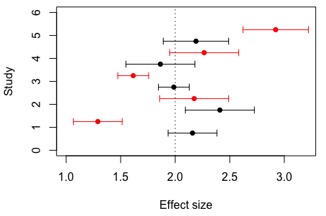
Random effect model data…
Mean (arrows are sampling standard deviation) effect size for each study. Data simulated under a fixed effect model in black and data simulated under a random effect model in red.

Slide 18
Random effects model meta-analysis..
# Random effect meta-analysis
metafor::rma(yi = esRE, vi = Ves, method="DL", data = dataRE)
## ## Random-Effects Model (k = 5; tau^2 estimator: DL) ## ## tau^2 (estimated amount of total heterogeneity): 0.2947 (SE = 0.2731) ## tau (square root of estimated tau^2 value): 0.5429 ## I^2 (total heterogeneity / total variability): 83.61% ## H^2 (total variability / sampling variability): 6.10 ## ## Test for Heterogeneity: ## Q(df = 4) = 24.4015, p-val < .0001 ## ## Model Results: ## ## estimate se zval pval ci.lb ci.ub ​ ## 2.0163 0.2697 7.4753 <.0001 1.4876 2.5449 *** ## ## --- ## Signif. codes: 0 '***' 0.001 '**' 0.01 '*' 0.05 '.' 0.1 ' ' 1

Slide 19
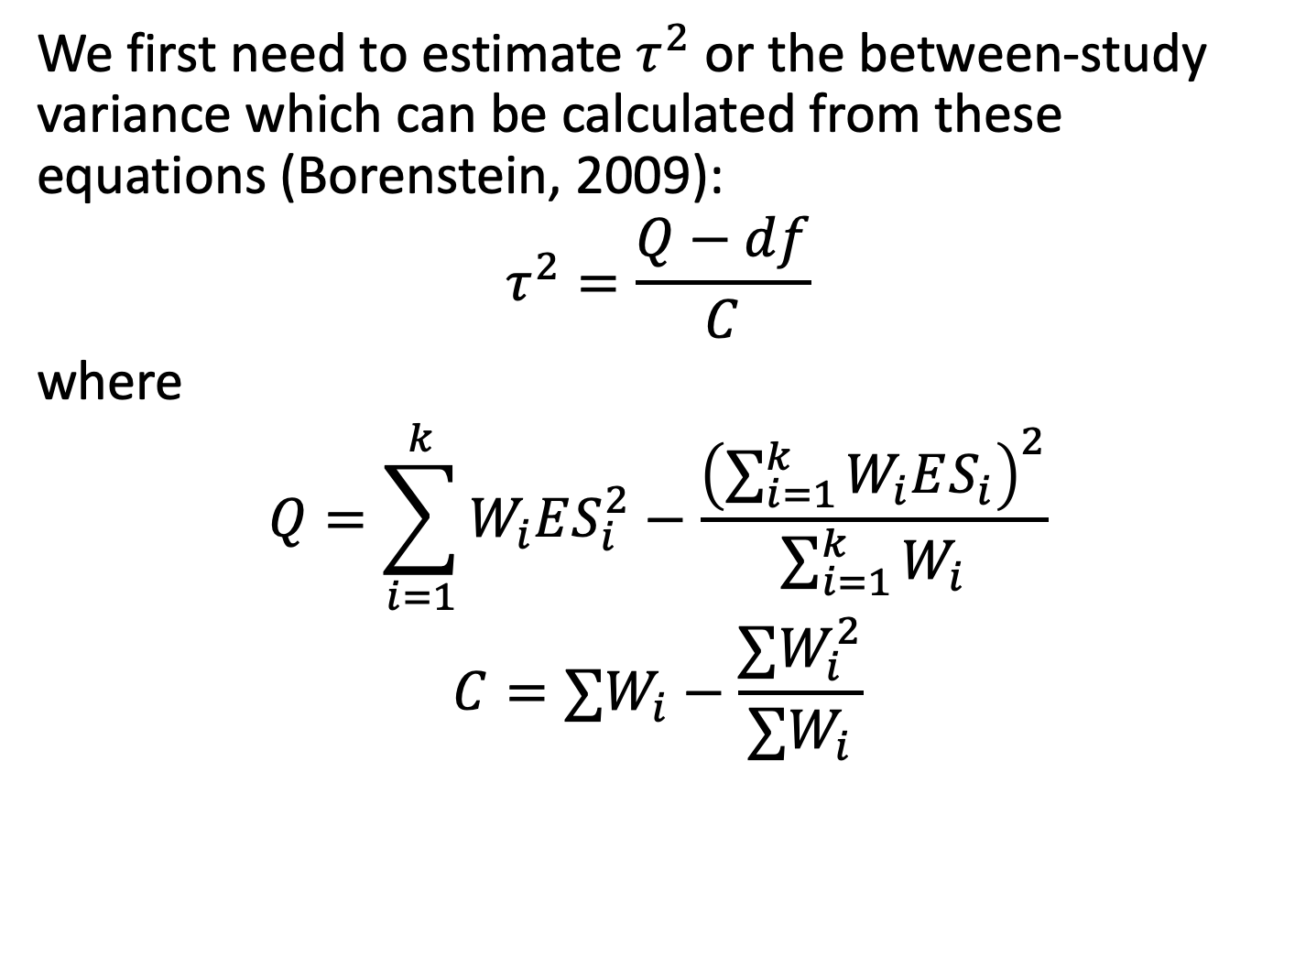
Now a random effect analysis by hand…
We first need to estimate $τ^{2}$ or the between-study variance which can be calculated from these equations (Borenstein, 2009):
$$τ^{2}=\frac{Q−df}{C}$$
where
$$Q=\sum_{i=1}^{k}{W_{i}ES_{i}^{2}}−\frac{{\left(\sum_{i=1}^{k}{W_{i}ES_{i}}\right)}^{2}}{\sum_{i=1}^{k}{W_{i}}}$$
$$C=∑W_{i}−\frac{∑W_{i}^{2}}{∑W_{i}}$$

Slide 20
Now a random effect analysis by hand…
# Calculate our Q statistic again Q <- sum(W*(dataRE$es^2) ) - (sum(W*dataRE$es)^2 / sum(W)) Q
## [1] 24.40149
# Calculate tau2 C <- sum(W) - ((sum(W^2))/sum(W)) C
## [1] 69.23077
# Calculate df df <- nrow(dataRE) - 1 T2 <- (Q - df) / C T2
## [1] 0.2946883
## Test for Heterogeneity: ## Q(df = 4) = 24.4015, p-val < .0001
## tau^2 (estimated amount of total heterogeneity): 0.2947 (SE = 0.2731)

Slide 21
Now a random effect analysis by hand…
Remember, things are the same but the weighting is different now.
# RE weights W.re <- 1 / (T2 + dataRE$Ves) #Pooled effect size for random effect meta-analysis esPoolRE <- sum(W.re*dataRE$es) / sum(W.re) esPoolRE
## [1] 2.016261
# Calculate the pooled variance around estimate VarES <- 1 / sum(W.re) # Calculate the standard error around estimate SE.ES.RE <- sqrt(VarES) SE.ES.RE
## [1] 0.2697219
## estimate se zval pval ci.lb ci.ub ​ ## 2.0163 0.2697 7.4753 <.0001 1.4876 2.5449 ***

Slide 22

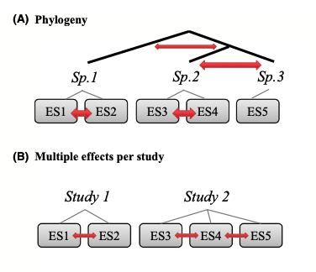
More complex non-independence

Slide 23
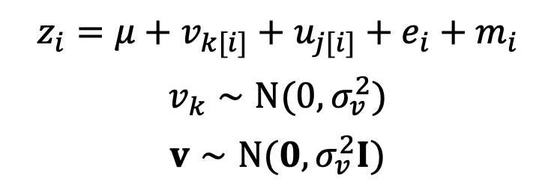
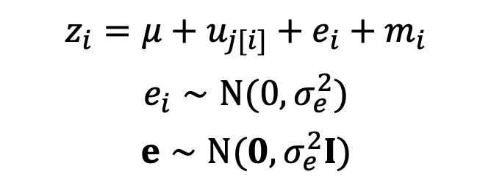
More complex meta-analysis: Multi-level meta-analysis
Multilevel meta-analysis 1
$$z_{i}=μ+u_{j[i]}+e_{i}+m_{i}$$
$$e_{i}∼N(0,σ_{e}^{2})$$
$$e∼N(0,σ_{e}^{2}I)$$
i = ith effect size
j = jth study
e = effect-size specific effect
Or = within-study effect
Or = residual
Multilevel meta-analysis 2
$$z_{i}=μ+v_{k[i]}+u_{j[i]}+e_{i}+m_{i}$$
$$v_{k}∼N(0,σ_{v}^{2})$$
$$v∼N(0,σ_{v}^{2}I)$$
v = species-specific effect
If species (kth species)
v = location-specific effect
If locations (kth location)

Slide 24
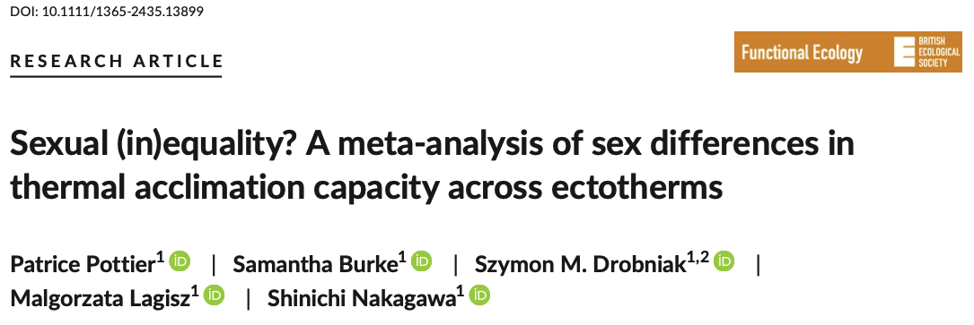
Example
# install.packages("pacman") ; uncomment this line if you haven't already installed 'pacman'
pacman::p_load(metafor, tidyverse) asr_dat <- read.csv("https://osf.io/qn2af/download")
#' @title arr #' @description Calculates the acclimation response ratio (ARR). #' @param t2_l Lowest of the two treatment temperatures #' @param t1_h Highest of the two treatment temperatures #' @param x1_h Mean trait value at high temperature #' @param x2_l Mean trait value at low temperature #' @param sd1_h Standard deviation of mean trait value at high temperature #' @param sd2_l Standard deviation of mean trait value at low temperature #' @param n1_h Sample size at high temperature #' @param n2_l Sample size at low temperature arr <- function(x1_h, x2_l, sd1_h, sd2_l, n1_h, n2_l, t1_h, t2_l){ ARR <- (x1_h - x2_l)/(t1_h - t2_l) V_ARR <- ((1/(t1_h - t2_l))^2*(sd2_l^2/n2_l + sd1_h^2/n1_h)) return(data.frame(ARR, V_ARR)) }

Slide 25
Caluclate ARR
# Calculate the effect sizes asr_dat <- asr_dat %>% mutate(ARR = arr(x1_h = mean_high, x2_l = mean_low,
t1_h = acc_temp_high, t2_l = acc_temp_low, sd1_h = sd_high, sd2_l = sd_low,
n1_h = n_high_adj, n2_l = n_low_adj)[, 1], V_ARR = arr(x1_h = mean_high, x2_l = mean_low,
t1_h = acc_temp_high, t2_l = acc_temp_low, sd1_h = sd_high, sd2_l = sd_low,
n1_h = n_high_adj, n2_l = n_low_adj)[,2]) %>% filter(sex == "female")

Slide 26
Multilevel Meta-analytic Model
# Multi-level meta-analytic model MLMA <- metafor::rma.mv(yi= ARR~ 1, V = V_ARR, method="REML", random=list(~1|species_ID, ~1|authors, ~1|es_ID), dfs = "contain", test="t", data=asr_dat) ## Multivariate Meta-Analysis Model (k = 123; method: REML) ## ## Variance Components: ## ## estim sqrt nlvls fixed factor ## sigma^2.1 0.0008 0.0280 29 no species_ID ## sigma^2.2 0.0154 0.1241 21 no authors ## sigma^2.3 0.0097 0.0987 123 no es_ID ## ## Test for Heterogeneity: ## Q(df = 122) = 3941.0055, p-val < .0001 ## ## Model Results: ## ## estimate se tval df pval ci.lb ci.ub ​ ## 0.1668 0.0316 5.2857 20 <.0001 0.1010 0.2327 *** ## ## --- ## Signif. codes: 0 '***' 0.001 '**' 0.01 '*' 0.05 '.' 0.1 ' ' 1

Slide 27
Multilevel Meta-analytic Model
# Multi-level meta-analytic model MLMA <- metafor::rma.mv(yi= ARR~ 1, V = V_ARR, method="REML", random=list(~1|species_ID, ~1|authors, ~1|es_ID), dfs = "contain", test="t", data=asr_dat) ## Multivariate Meta-Analysis Model (k = 123; method: REML) ## ## Variance Components: ## ## estim sqrt nlvls fixed factor ## sigma^2.1 0.0008 0.0280 29 no species_ID ## sigma^2.2 0.0154 0.1241 21 no authors ## sigma^2.3 0.0097 0.0987 123 no es_ID ## ## Test for Heterogeneity: ## Q(df = 122) = 3941.0055, p-val < .0001 ## ## Model Results: ## ## estimate se tval df pval ci.lb ci.ub ​ ## 0.1668 0.0316 5.2857 20 <.0001 0.1010 0.2327 *** ## ## --- ## Signif. codes: 0 '***' 0.001 '**' 0.01 '*' 0.05 '.' 0.1 ' ' 1
Overall meta-analytic mean as 0.167
95% confidence interval of 0.101 to 0.233
Each degree increase in acclimation temperature female heat tolerance changes by an average of 0.167∘C

Slide 28
Phylogenetic meta-analysis

Slide 29
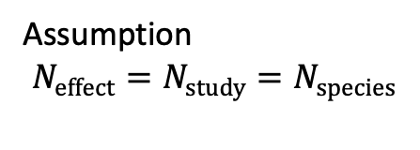
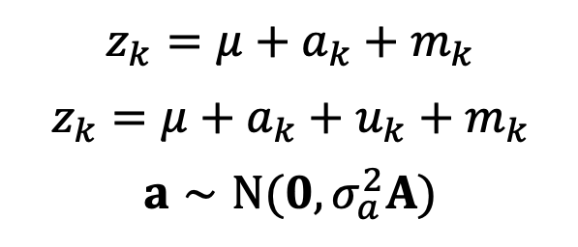
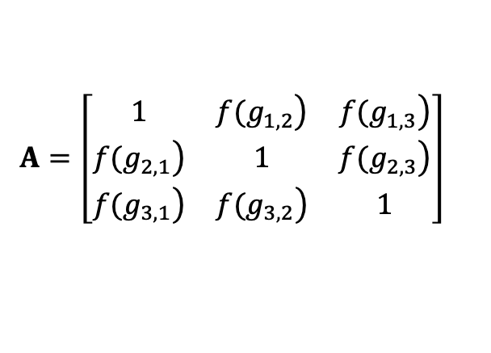
Phylogenetic meta-analysis
Phylogenetic common-effect & random-effects models
$$z_{k}=μ+a_{k}+m_{k}$$
$$z_{k}=μ+a_{k}+u_{k}+m_{k}$$
$$a∼N(0,σ_{a}^{2}A)$$
Adams (2008)
Lajeunesse (2009)
a = phylogenetic effect
kth species
Assumption
$$N_{effect}=N_{study}=N_{species}$$
The case with 3 effect sizes (species)
$$A=\left[\begin{matrix}1 & \left.f(g_{1,2}\right) & \left.f(g_{1,3}\right) \\ \left.f(g_{2,1}\right) & 1 & \left.f(g_{2,3}\right) \\ \left.f(g_{3,1}\right) & \left.f(g_{3,2}\right) & 1\end{matrix}\right]$$
A = correlation matrix of species distances
f = function; g = distance between the root and the common ancestor

Slide 30
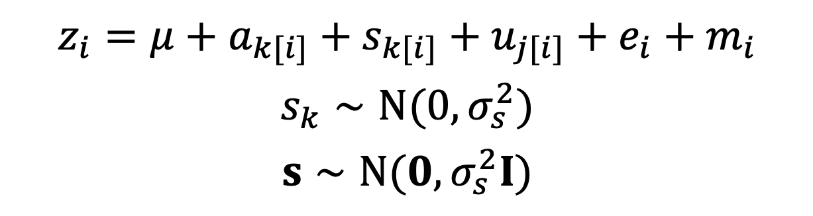
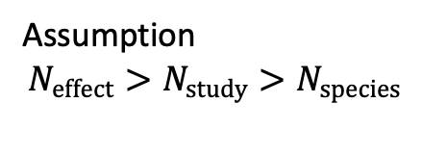
$$z_{i}=μ+a_{k[i]}+s_{k[i]}+u_{j[i]}+e_{i}+m_{i}$$
$$s_{k}∼N(0,σ_{s}^{2})$$
$$s∼N(0,σ_{s}^{2}I)$$
s = non-phylogenetic part of species effect
Assumption
$$N_{effect}>N_{study}>N_{species}$$
Stop and think: it is all good in theory…..
Can we distinguish s and u?

Slide 31
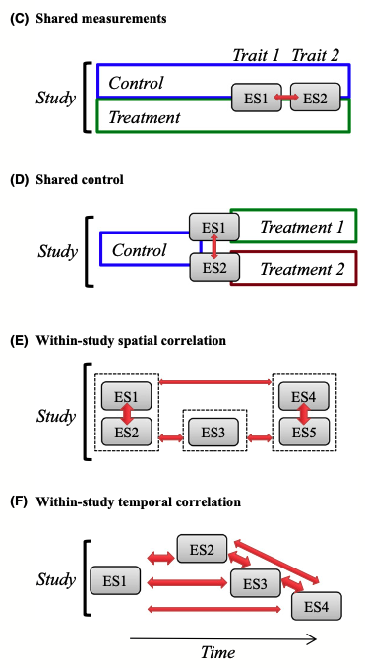
More complex non-independence
But see also:
- Gleser & Olkin (2009)
- Lajeunesse (2011)
- Koricheva et al. (2013)

Slide 32
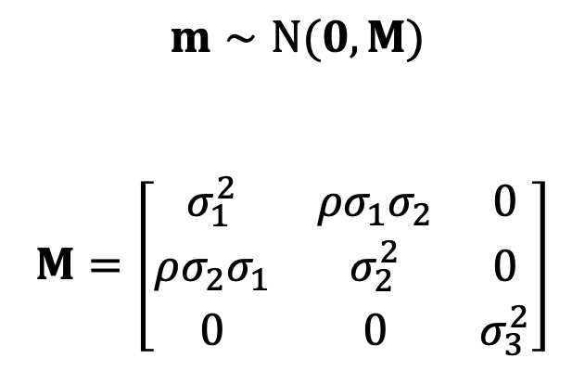
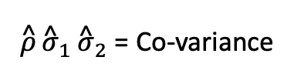
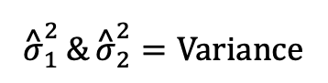
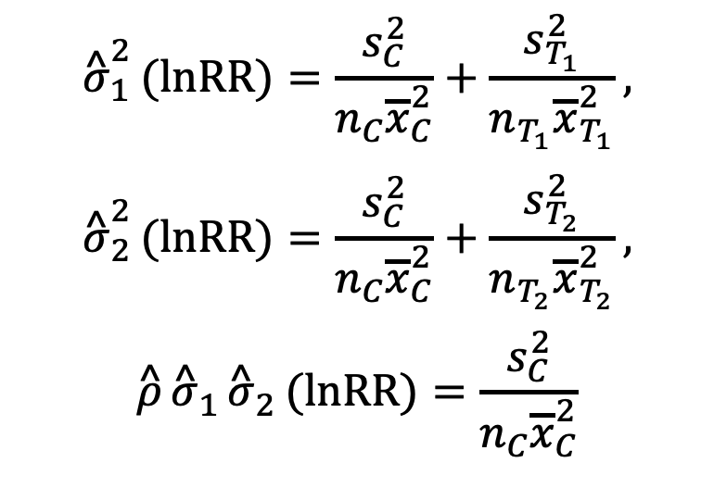
Shared-Control Non-independence
$m∼N(0,M)$
$$M=\left[\begin{matrix}σ_{1}^{2} & ρσ_{1}σ_{2} & 0 \\ ρσ_{2}σ_{1} & σ_{2}^{2} & 0 \\ 0 & 0 & σ_{3}^{2}\end{matrix}\right]$$
$${\overset{^}{σ}}_{1}^{2}(lnRR)=\frac{s_{C}^{2}}{n_{C}{\overline{x}}_{C}^{2}}+\frac{s_{T_{1}}^{2}}{n_{T_{1}}{\overline{x}}_{T_{1}}^{2}},$$
$${\overset{^}{σ}}_{2}^{2}(lnRR)=\frac{s_{C}^{2}}{n_{C}{\overline{x}}_{C}^{2}}+\frac{s_{T_{2}}^{2}}{n_{T_{2}}{\overline{x}}_{T_{2}}^{2}},$$
$$\overset{^}{ρ}{\overset{^}{σ}}_{1}{\overset{^}{σ}}_{2}(lnRR)=\frac{s_{C}^{2}}{n_{C}{\overline{x}}_{C}^{2}}$$
The case with 3 effect sizes
$${\overset{^}{σ}}_{1}^{2}\&{\overset{^}{σ}}_{2}^{2}=Variance$$
$\overset{^}{ρ}{\overset{^}{σ}}_{1}{\overset{^}{σ}}_{2}$ = Co-variance
M will usually be a “block-diagonal” matrix
Lajeunesse (2011), Ecology & Gleser and Olkin (2009).

Slide 33
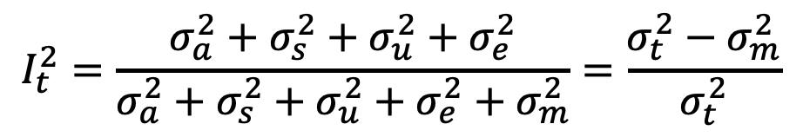
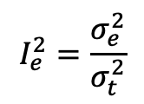
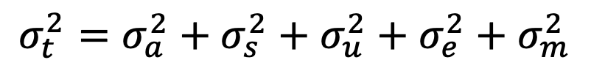
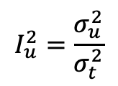
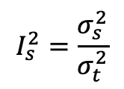
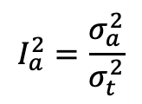
Heterogeneity: I² for multilevel models
Proportion of variation relative to total
I²_{t(total)} : Proportion of variance among effects after removing sampling variation
t = total
a = phylogenetic
s = non-phylogenetic spp
u = study
e = effect size
m = sampling error
$$σ_{t}^{2}=σ_{a}^{2}+σ_{s}^{2}+σ_{u}^{2}+σ_{e}^{2}+σ_{m}^{2}$$
$$I_{t}^{2}=\frac{σ_{a}^{2}+σ_{s}^{2}+σ_{u}^{2}+σ_{e}^{2}}{σ_{a}^{2}+σ_{s}^{2}+σ_{u}^{2}+σ_{e}^{2}+σ_{m}^{2}}=\frac{σ_{t}^{2}−σ_{m}^{2}}{σ_{t}^{2}}$$
$$I_{a}^{2}=\frac{σ_{a}^{2}}{σ_{t}^{2}}$$
$$I_{s}^{2}=\frac{σ_{s}^{2}}{σ_{t}^{2}}$$
$$I_{u}^{2}=\frac{σ_{u}^{2}}{σ_{t}^{2}}$$
$$I_{e}^{2}=\frac{σ_{e}^{2}}{σ_{t}^{2}}$$
Nakagawa & Santos (2012)

